Slide 1
Introduction
Dr. Rafael Kuffner dos Anjos

Slide 2
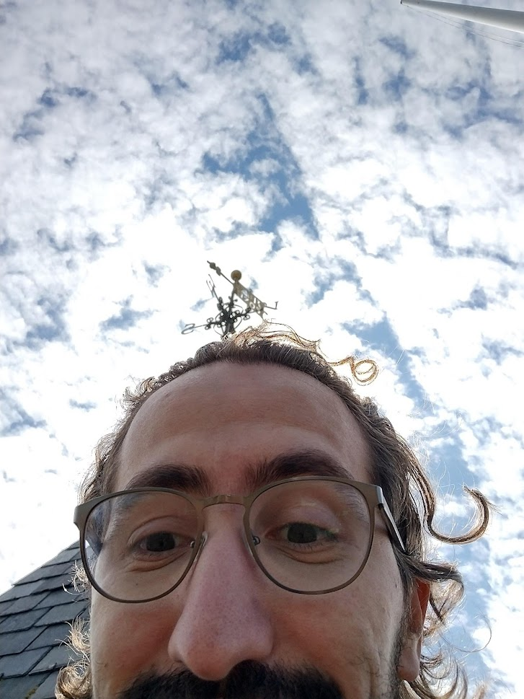
Me
Brazilian. Sorry about my inglês.
I accept any pronunciation of my name that is not Ralph.
Research in Graphics, mostly applied to VR/AR, and point clouds!
Have collaborated with games/movie industry in Japan.
I like most things (movies, games, books, food, animals, TV, sports, hobbies), except when it comes to music, which I’m very particular about.
Office at 2.04d. Usually around Bragg building. Come meet me IRL and have a chat.
I have a wife, a baby, and a dog. You may get lucky and see them around.

Slide 3
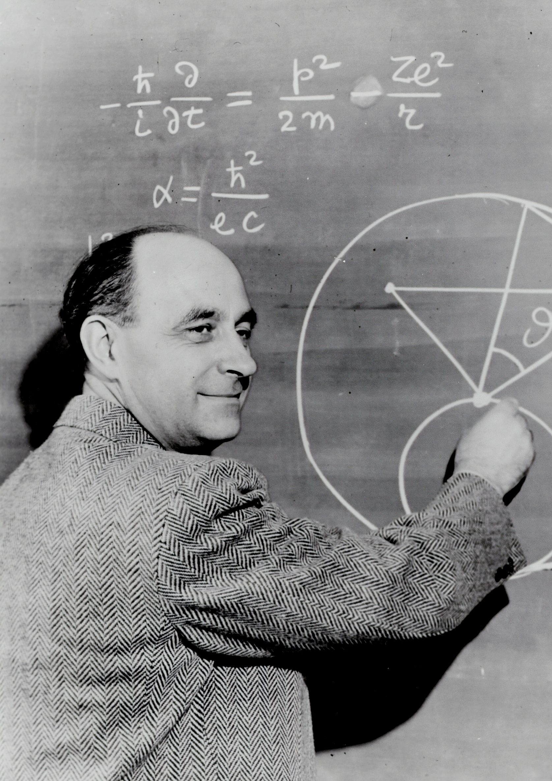
In this module
Graphics is built on mathematics!
Objects
Light
Images

Slide 4
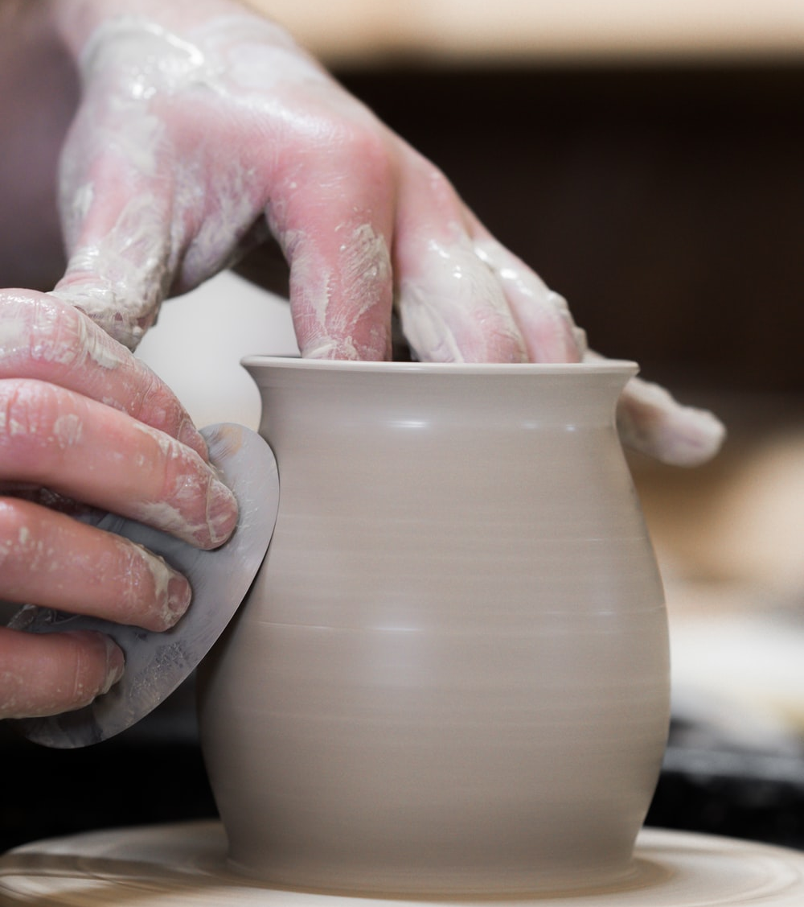

In practice
Data Intensive
Processor Intensive

Slide 5
(Modelling &) Rendering
Our focus: rendering
Necessary to cover: Geometric models, Textures & Material properties
More modelling is in Geometric Processing

Slide 6

Rendering
Barycentric Interpolation
Geometric Intersection Tests
Projective Rendering
Physics of Light
Materials & Scattering
Rendering Solutions
Parallel Implementations & Shaders

Slide 7


Reference Text
Some times 1 chapter/lecture other times several.
Mostly reference, not strictly.
Reading reference available on Minerva

Slide 8

Previous knowledge
We assume you know basic OpenGL (1.4)
Ch. 1-13 of the textbook
And basic Qt/other GUI development
If you don’t, it should also be okay!

Slide 9
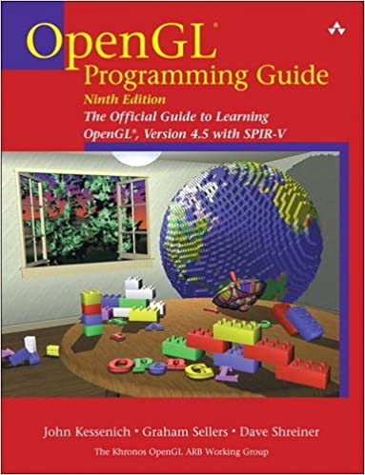

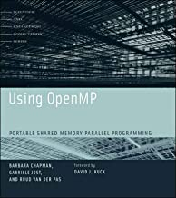
Support literature: Fixed Function Pipeline
Paperback: £33.99
Kindle: £29.16
ACM: $20.00
Paperback: £44.30
ACM: $20.00
Paperback: £38.24
Earlier versions online

Slide 10
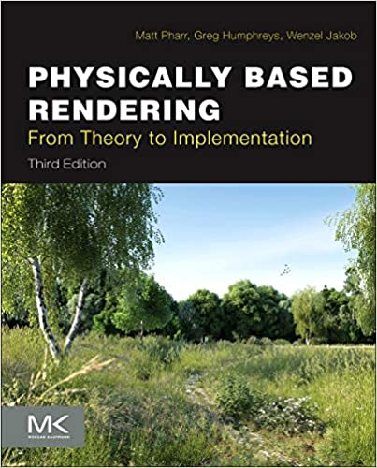


Raytracing
Online: £0.00
Academy Award
(Turing Award)
Online: £0.00
Hardback: £32.53
Kindle: £0.00

Slide 11


Shader languages
DirectX 12
Programming
Guide
Paperback: £99.68
Kindle: £19.33
ACM: $20.00
Paperback: £34.99
Kindle: £29.16
ACM: $20.00
Microsoft: £0.00
(No Image)

Slide 12
Evaluation
A1 (weeks 3-9): 50%
Parallel OpenGL Renderer in Software
A2 (weeks 9-14): 50%
Recursive Raytracer in Software
No Exam!

Slide 13
Week | Dates | Wednesday | Thursday | Lab | In | Out
1 | 27 set - 01 oct | Projective Rendering | Homogeneous Transformations | Matrix exercise
2 | 04 oct - 08 oct | Quaternions | Triangle Rasterisation & Shading | Quaternion Exercise
3 | 11 oct -15 oct | Textures & Mip-maps | Parallel Implementation | Assignment 1 discussion |  | A1
4 | 18 oct - 22 oct | Shaders & GPU Architecture | Vertex Buffers | Assignment 1 support
5 | 25 oct - 29 oct | Reading Week | Reading Week
6 | 01 nov - 05 nov | GLSL Pipelines & Shaders | Building a Phong Shader | Assignment 1 support
7 | 08 nov - 12 nov | Materials & Scattering | Geometric Intersections | Assignment 1 support
8 | 15 nov - 19 nov | Monte Carlo Sampling | Recursive Raytracing | Assignment 2 discussion
9 | 22 nov - 26 nov | Images & Filtering | Physics of Light & Colour | Assignment 2 support | A1 | A2
10 | 29 nov - 03 dec | Alternate Rendering Methods | Non-Photorealistic Rendering | Assignment 2 support
11 | 06 dec - 10 dec | Volume Rendering | Review | Assignment 2 support
12 | 13 dec - 17 dec | No Lectures | No Lectures
- | 18 dec - 03 jan | End of year break
- | 03 jan - 07 jan | Study Week
13 | 10 jan – 14 jan | Exam period
14 | 17 jan – 21 jan | Exam period |  |  | A2

Slide 14
Where in the books?
Projective Rendering | Hughes 3,6,7,13
Homogeneous Transformations | Hughes 10,11
Quaternions
Triangle Rasterisation & Shading | Hughes 6, 9.2
Textures & Mip-maps | Hughes 20
Parallel Implementation | Kessenich
Shaders & GPU Architecture | Hughes 33, Kessenich, Sellers
Vertex Buffers | Rost, Sellers
GLSL Pipelines & Shaders | Rost, Sellers
Building a Phong Shader | Rost, Sellers
Images & Filtering | Hughes 18, 19, 20
Physics of Light & Colour | Hughes 26, 28
Materials & Scattering | Hughes 27
Geometric Intersections | Hughes 7.7 - 7.8
Monte Carlo Sampling | Hughes 30
Recursive Raytracing | Hughes 15, 29, 31, 32
Alternate Rendering Methods | Hughes 15, 31
Volume Rendering | Hughes 27
Non-Photorealistic Rendering | Hughes 34
Review

Slide 15
Overview
Maths fundamentals for computer graphics
Rasterization
OpenGL implementation
Raytracing
Alternate Rendering methods

Slide 16
Assignments:
Out on Thursdays, In on Fridays, always 10 am.
14 Oct.
A1 out
25 Nov.
A2 out
21 Jan.
A2 in
End of year break
Rest!
26 Nov.
A1 in

Slide 17
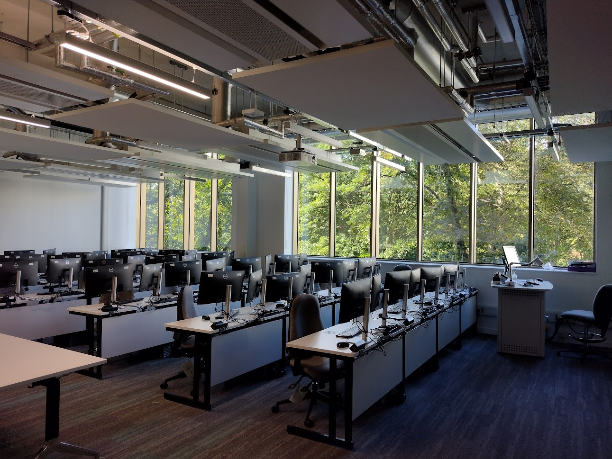
Equipment & Labs
We have access to the lab!!!!!!
All the assignments can be done:
Using feng-linux.leeds.ac.uk(/gpu)
At home on your own machine
Windows / Linux / ? OS X ?
But please make it work on feng
I assume QT 5.13.0 / OpenGL 4.5

Slide 18
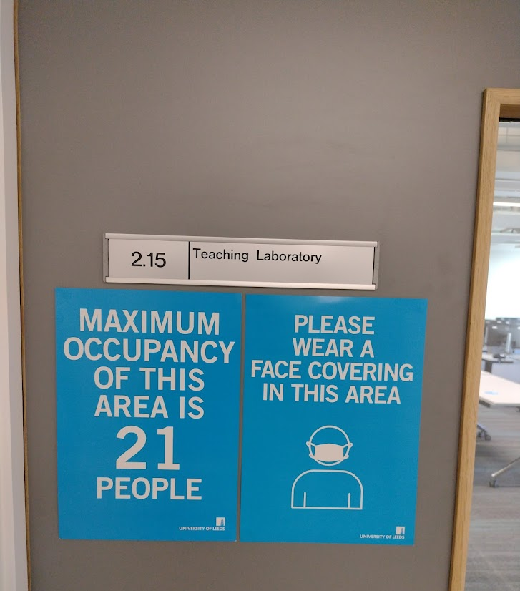
Lab Sessions
Thursday 3.00-5.00 pm
Shared slot with Geometric Processing
First few weeks, exercises.
Afterwards, Q&A session.
Because of the maximum occupancy, we will be breaking you into 4 groups.

Slide 19
Groups
We will break it into 4 groups:
Group A will meet Hamish at 1500, me at 1530
Group B will meet me at 1500, Hamish at 1530
Group C will meet Hamish at 1600, me at 1630
Group D will meet me at 1600, me Hamish 1630
Basically 2 slots: 15.00 and 16.00, and we do it all together.

Slide 20
Group A - 1500 HC, 1530 RK
M. Eng.
Matthew Cumber
Siyuan Fan
Isaiah Fergile-Leybourne
Alexander Goose
Jason (Zecheng) Hu
M. Sci.
Sharo Hama Karim
Niall Horn
Chaoshan Huang
Jason Kharmawphlang
Yichen Xiao

Slide 21
Group B - 1500 RK, 1530 HC
M. Eng.
John Barbone
Sven Buckland
Vincent (Chan) Lou
Natasha Newland
M. Sci.
Nikhil Bharadwaj
Jiaxing Cai
Zekun Cai
Yiu Ho
Eleanor Mills
Shihua Wu

Slide 22
Group C - 1600 HC, 1630 RK
M. Eng.
Ciaran Brennan
Lewis Hadley
Parmvir Grewal
Tomas Martinek
M. Sci.
Yizhou Hu
Huayang Jiang
Wei Pan
Tianyi Yan
Jingyuan Zhang
Zhiyang Zhang

Slide 23
Group D - 1600 RK, 1630 HC
M. Eng.
Domantas Dilys
Mario Ivanov
Ramal Cooray
Usama Usman
M. Sci.
Jacob Bennett
Zechen Geng
Sharjeel Qaiser
Yuxuan Wen
Xiaoyuan Yang
Jinyun Zhu

Slide 24
Images by
S2- scienceinhd,
S3- courtney cook, Sincerely Media,
S7- thoughtcatalog
From Unsplash.com

